Slide 1

Being a
Better Ally
to All

Slide 2


Jessica Pettitt
@jesspettitt
Jess@GoodEnoughNow.com
(202) 670-4262 text

Slide 3

Learning Objectives:
Improving Listening Skills during difficult conversations or conflict
Asking better questions through your conscious and unconscious bias
Taking responsibility for who and how you show up
in relationship with key stakeholders, leaders, colleagues, etc.

Slide 4

What is the
goal
of being an ally?

Slide 5
Discrimination is bad for business.

Slide 6


Slide 7
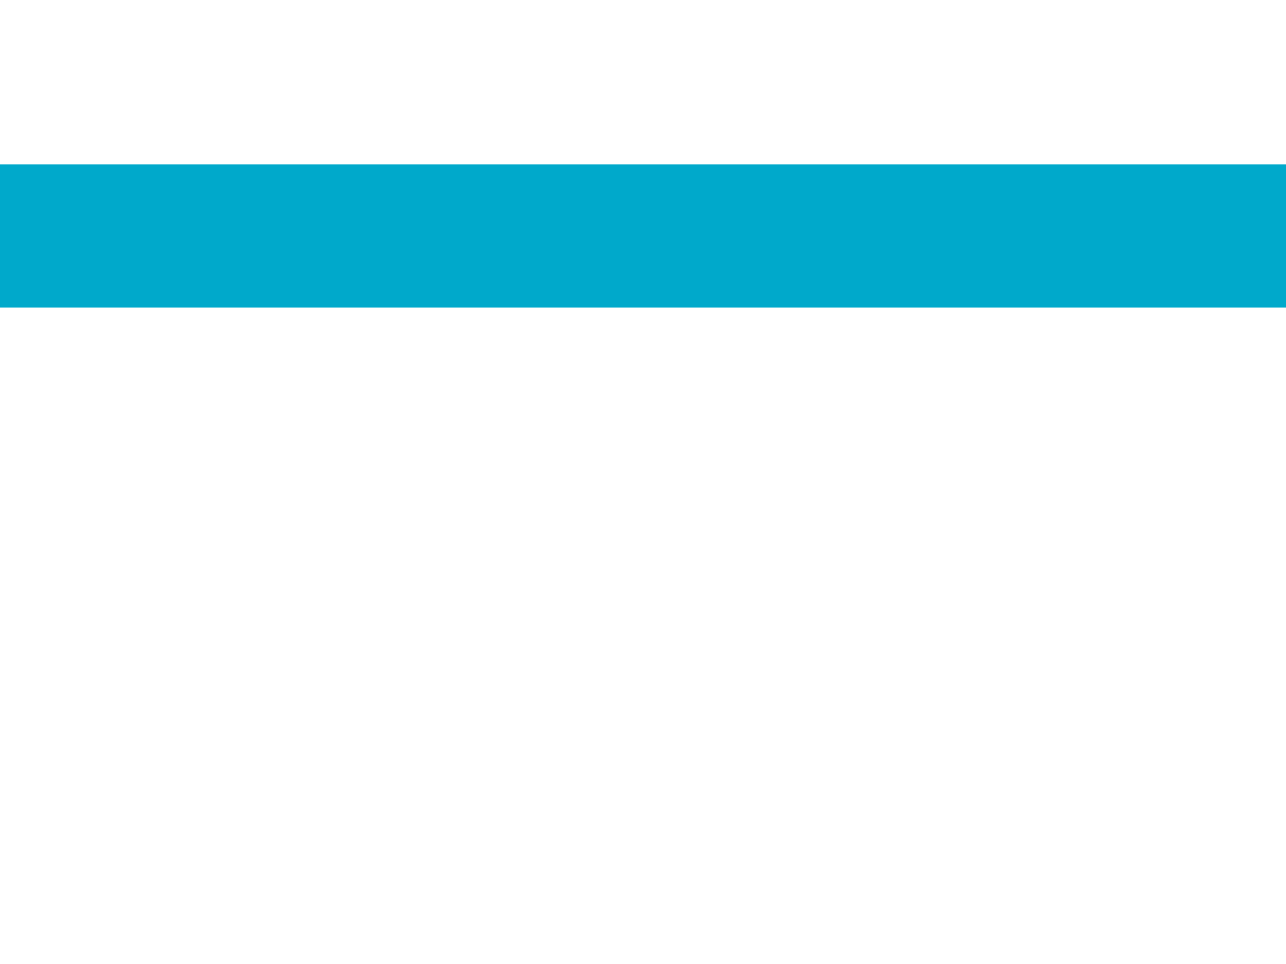
Being an ally is work.

Slide 8
Where do I start?

Slide 9

Notes:
Perception/validation VS self reflection/responsibility

Slide 10
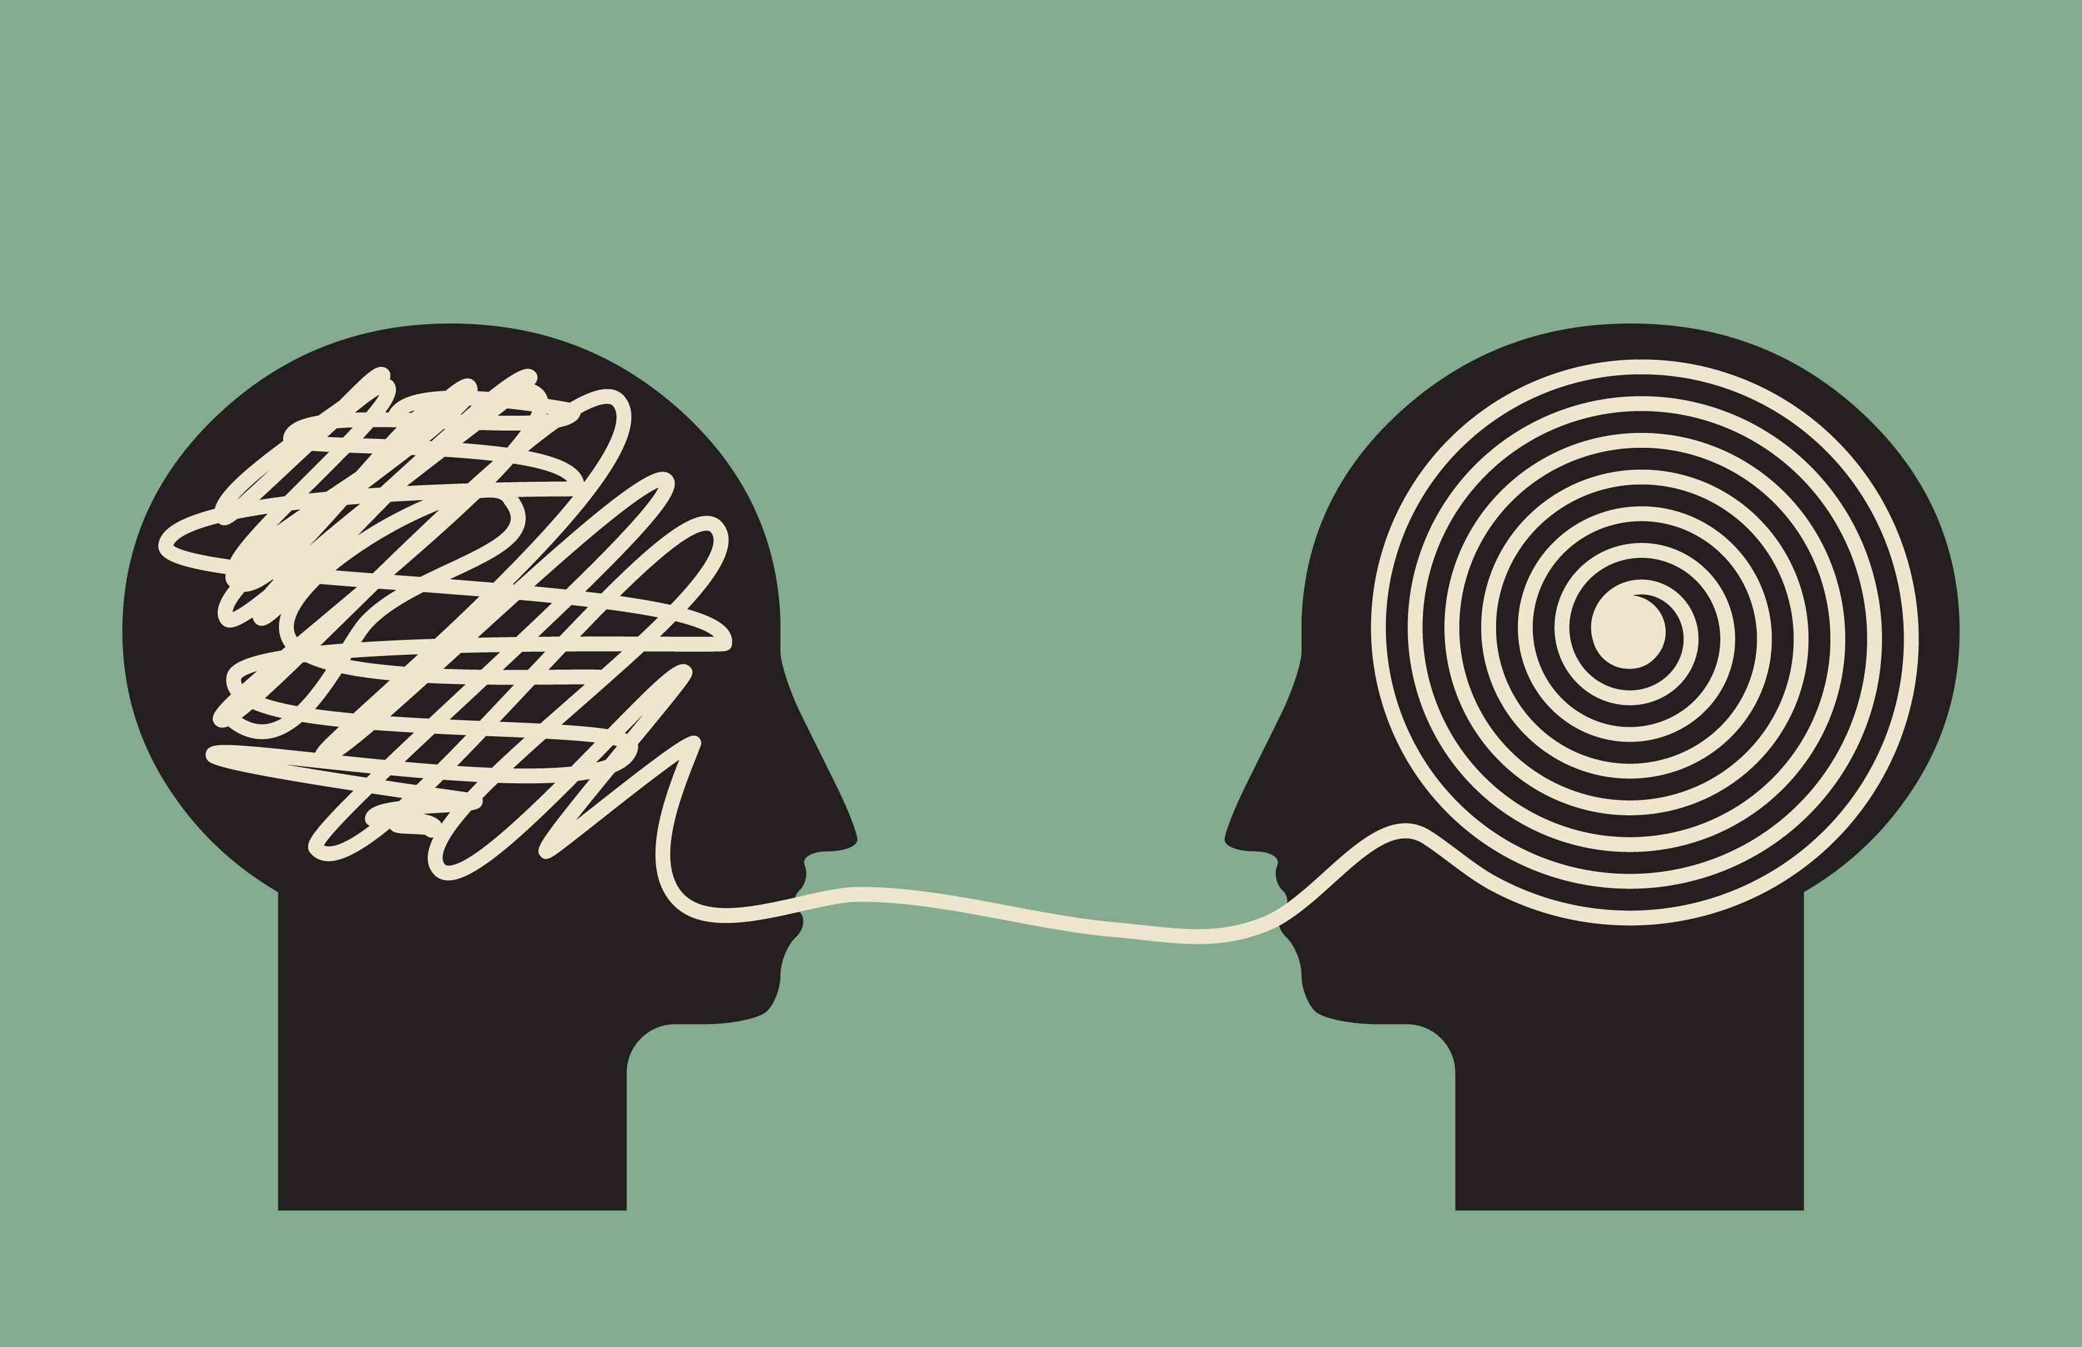

Slide 11
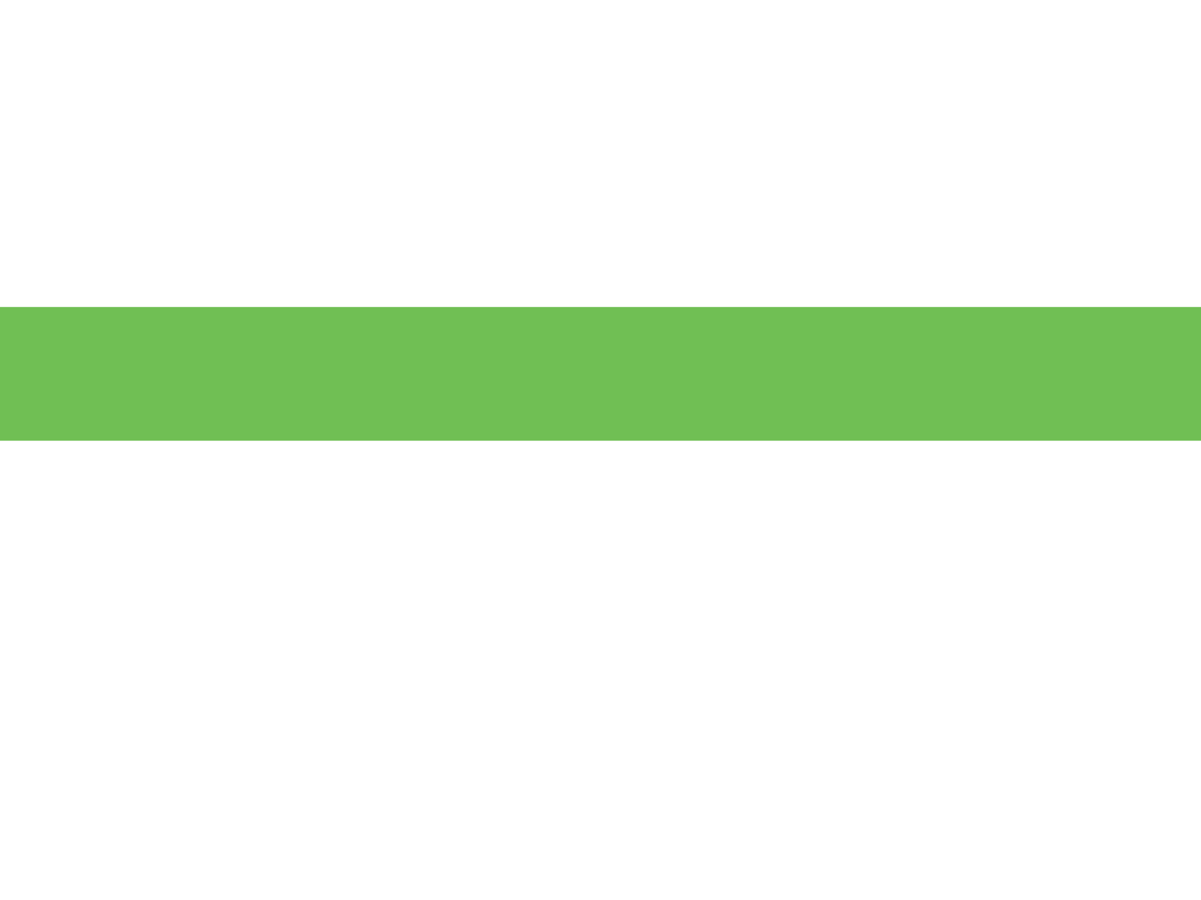
Who suffers most in
this scenario?

Slide 12
Who suffers most in
this scenario?

Slide 13
Who suffers most in
this scenario?

Slide 14
Who suffers most in
this scenario?

Slide 15
Who suffers most in
this scenario?

Slide 16
Who suffers most in
this scenario?

Slide 17
Who suffers most in
this scenario?

Slide 18
Who suffers most in
this scenario?

Slide 19
Who suffers most in
this scenario?
The burden then lands on them to catch up, educate others, speak up, and educate the most empowered and privileged group members around language, stereotypes, prejudices, acts of discrimination, bias, and the reality of complex identities and relationships.

Slide 20
This is EXACTLY what being an ally to all ISN’T.

Slide 21

How do I prepare?

Slide 22
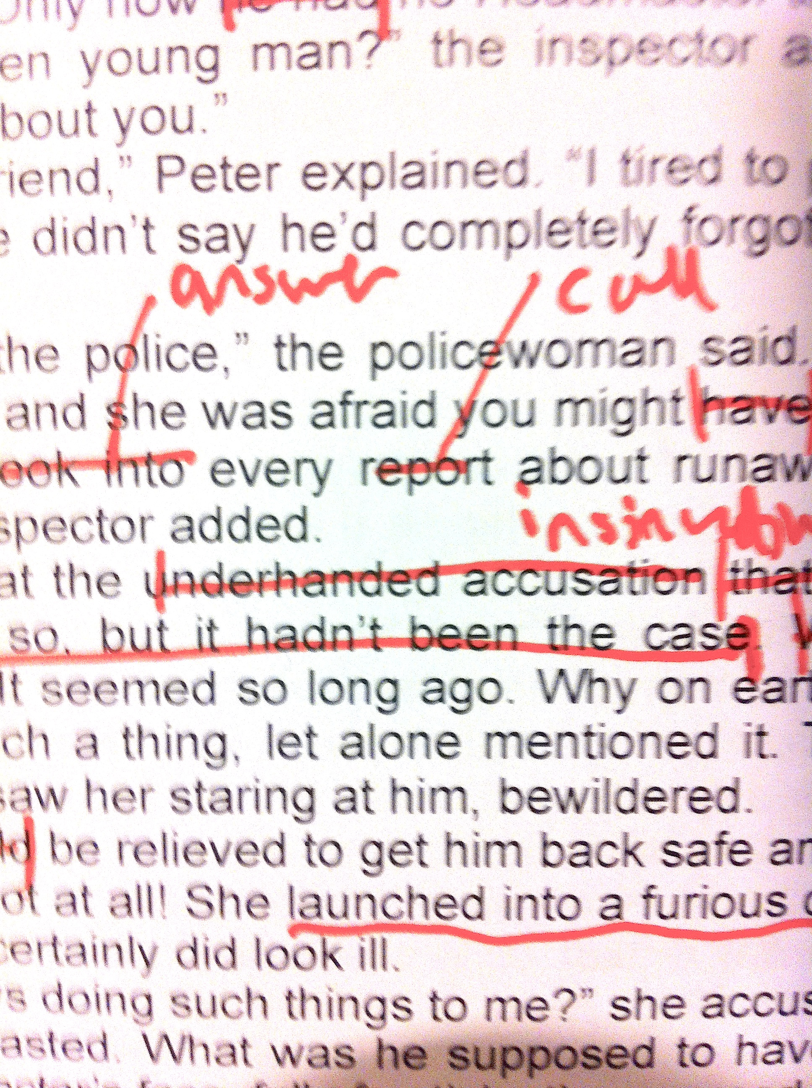

Slide 23
Leave room for edits.

Slide 24
We can be right.
We can also go the extra step and be more accurate.

Slide 25

Being an ally to all is about them and less about you.

Slide 26
Keep listening.

Slide 27
Keep it about them and you can change the story they have written about
you.

Slide 28
Questions?

Slide 29
HOW TO BE AN ALLY TO ALL – THE BASICS
Do not use pejorative language (real man/woman,
real married, lifestyle, choices, etc.)
Decline to gossip
Respect privacy
Take notes of preferred name, family connections
Avoid exclusive behaviors like isolating from the main group, suppressing differences and requiring assimilation, tolerating but not valuing differences
Avoid micro-inequities (small, subtle behaviors
that devalue others)
    interruptions
    ignoring or neglecting individuals
    making others feel “out of the loop”

Slide 30

HOW TO BE AN ALLY TO ALL – THE BASICS
The Golden Rule

Slide 31


Slide 32
HOW TO BE AN ALLY TO ALL – THE BASICS
The Platinum Rule

Slide 33
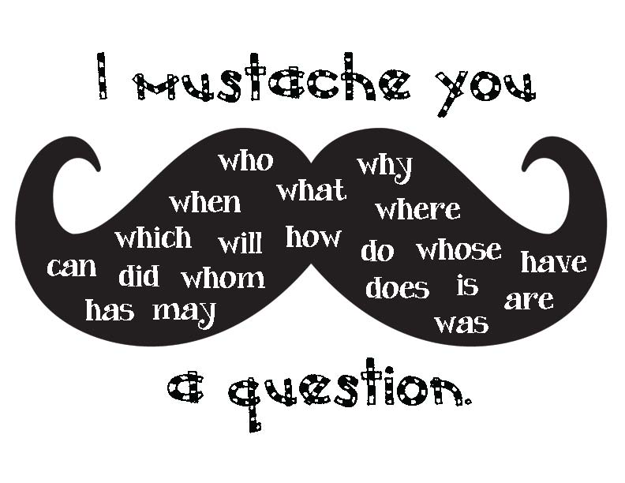

Slide 34
HOW TO BE AN ALLY TO ALL – THE BASICS
The Platinum Rule
Listening
Asking Appropriate Questions
Making Referrals
Self-educating and Awareness
Listen for:
Descriptors of family members, relationships, and other
key players in this person’s life and go with it
Trust that they know their situation better than you

Slide 35
They are choosing how much to disclose to you.

Slide 36
Pay attention
&
listen.

Slide 37
We have all used bad listening skills & we know when someone isn’t really listening to us.

Slide 38
Asking Questions Respectfully.

Slide 39
Remember, the other person knows themselves better than you do.

Slide 40
Being an ally to all is about them and less about you.

Slide 41
Three kinds of knowledge:
1) what you know you know
2) what you know you don’t know
3) what you don’t know you don’t know

Slide 45
Three kinds of knowledge:
1) what you know you know
2) what you know you don’t know
3) what you don’t know you don’t know

Slide 46
Questions?

Slide 47
DO YOUR HOMEWORK!
Note new terms
Note discomfort or confusion and seek the source
Share your experiences with key people in your life and learn from others.

Slide 48
Knowing yourself allows you to know what you don’t know.

Slide 49
Being an ally is about being comfortable with what you don’t know and taking responsibility for this lack of knowledge.

Slide 50
Questions?

Slide 51

CALL TO ACTION

Slide 53
Don’t forget to download the bonus handouts Ally Path & Better Connections to keep conversations stirring!

Slide 54
Jessica Pettitt
@jesspettitt
Jess@GoodEnoughNow.com
(202) 670-4262 text

